Slide 1
7. Hashing

Slide 2
Objectives
2
Why Hashing?
Hash Table
Hash Functions
Collision Resolution
Deletion
Perfect Hash Functions
Hash Functions for Extendable files
Hash code
Maps
Hashing in java.util
Notes:
2

Slide 3
Why hashing?
3
If data collection is sorted array, we can search for an item in O(log n) time using the binary search algorithm.
However with a sorted array, inserting and deleting items are done in O(n) time.
If data collection is balanced binary search tree, then inserting, searching and deleting are done in O(log n) time.
Is there a data structure where inserting, deleting and searching for items are more efficient?
The answer is “Yes”, that is a Hash Table.
Notes:
3

Slide 4
Hash Tables
We’ll discuss the hash table ADT which supports only a subset of the operations allowed by binary search trees.
The implementation of hash tables is called hashing.
Hashing is a technique used for performing insertions, deletions and finds in constant average time (i.e. O(1))
This data structure, however, is not efficient in operations that require any ordering information among the elements, such as findMin, findMax and printing the entire table in sorted order.
Data Structures and Algorithms in Java

Slide 5
General Idea
The ideal hash table structure is merely an array of some fixed size, containing the items.
A stored item needs to have a data member, called key, that will be used in computing the index value for the item.
  Key could be an integer, a string, etc
  e.g. a name or Id that is a part of a large employee structure
The size of the array is TableSize.
The items that are stored in the hash table are indexed by values from 0 to TableSize – 1.
Each key is mapped into some number in the range 0 to TableSize – 1.
The mapping is called a hash function.
Data Structures and Algorithms in Java

Slide 6
Hash Table Example - 1
Hash
Table
0
1
Items
Hash
Function
2
john 25000
3
john 25000
phil 31250
key
4
phil 31250
dave 27500
5
mary 28200
6
dave 27500
7
mary 28200
key
8
9
Data Structures and Algorithms in Java

Slide 7
Hash Function - 1
The hash function:
  must be simple to compute.
  must distribute the keys evenly among the cells.
If we know which keys will occur in advance we can write perfect hash functions, but in many cases we don’t.
Data Structures and Algorithms in Java

Slide 8
Hash Function - 2
Problems:
Keys may not be numeric.
Number of possible keys is much larger than the space available in table.
Different keys may map into same location
  Hash function is not one-to-one => collision.
  If there are too many collisions, the performance of the hash table will suffer dramatically.
Data Structures and Algorithms in Java

Slide 9
Hash Function - 3
If the input keys are integers then simply Key mod TableSize is a general strategy.
  Unless key happens to have some undesirable properties. (e.g. all keys end in 0 and we use mod 10)
If the keys are strings, hash function needs more care.
  First convert it into a numeric value.
Data Structures and Algorithms in Java

Slide 10
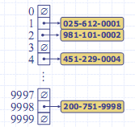
Hash table example - 2
10
We design a hash table for a map storing entries as (ID, Name), where ID is a nine-digit positive integer
Our hash table uses an array of size N = 10,000 and the hash function h(x) = last four digits of x
Notes:
Example: Goodrich’s
10

Slide 11
How to select Hash Functions?
We want a hash function that is easy to compute and that minimizes the number of collisions.
Hashing functions should be unbiased.
  That is, if we randomly choose a key, x, from the key space, the probability that f(x) = i is 1/M, where M is the size of the hash table.
  We call a hash function that satisfies unbiased property a uniform hash function.

Slide 12
Division Hash Functions
Division h_{D}(x) = x % M :
  Using the modulus (%) operator.
  We divide the key x by some number M and use the remainder as the hash index for x.
    This gives indexes that range from 0 to M - 1,
    where M = that table size (hash table).
The choice of M is critical.
  If M is divisible by 2, then odd keys to odd indexes and even keys to even ones. (biased!!)
  If M is a power of 2, i.e. m = 2^p , then h(k) is just the p lowest-order bits of k. (biased!!)
  If M = pH, then keys in the set {H, 2H, 3H, …, (p-1)H, pH, (p+1)H,…, kH,…} map to p positions {H, 2H, 3H, …, (p-1)H, 0} only (biased!!)
  A good choice for M would be : M a prime number such that M does not divide r^{k}±a for small k and a.

Slide 13
Folding Hash Functions
Folding
  Partition key x into several parts.
  All parts except for the last one have the same length.
  Add the parts together to obtain the value y, the hash index then is h(x) = y % M.
Two possibilities (divide x into several parts)
  Shift folding:
  Shift all parts except for the last one, so that the least significant bit of each part lines up with corresponding bit of the last part. Suppose x = 72320354121324
    x₁=723, x₂=203, x₃=541, x₄=213, x₅=24,
    index= (x₁ + x₂ + x₃ + x₄ + x₅) % 1000 = 1704%1000 = 704
  Boundary folding (folding at the boundaries):
  reverses every other partition before adding
    x₁=723, x₂=302, x₃=541, x₄=312, x₅=24, index=1902%1000 = 902

Slide 14
Other Hash Functions
14
In the mid-square method, the key is squared and the middle or mid part of the result is used as the address
Exp: key = 3121² = 9 740 641 ->index = 406 mod Tsize
Since the middle bits of the square usually depend upon all the characters in a key, there is high probability that different keys will produce different hash indexes.
In the extraction method, only a part of the key is used to compute the address
Exp: 123-45-6789->1234-5-6789 -> index = 1289 mod TSize
Using the radix transformation, the key K is transformed into another number base; K is expressed in a numerical system using a different radix.
Exp: 345₁₀ = 423₉ -> index = 423 mod TSize

Slide 15
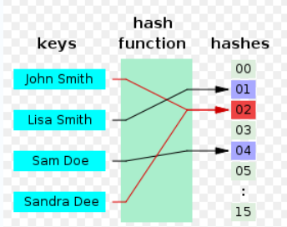
Collision
15
Collisions occur when different elements are mapped to the same cell
Notes:
Image source:http://en.wikipedia.org/wiki/File:Hash_table_4_1_1_0_0_1_0_LL.svg
15

Slide 16
Collision Resolution
Open addressing method
16
In the open addressing method, when a key x collides with another key, the collision is resolved by finding an available table entry other than the position (address) to which the colliding key is originally hashed. Thus, if the position k = h(x) is used, then the following positions are tried:
k = h_{i}(x) = h(x)+ p(i) mod M, i = 1, 2, ... (M = Tsize)
  The simplest method is linear probing, for which p(i) = i, and for the ith probe, the position to be tried is (h(x) + i) mod M,
  i = 1,2,…
  Quadratic: p(i) = i² thus the position to be tried is (h(x) + i²) mod M, i = 1,2,…
Notes:
Linear probing = thăm dò tuyến tính
16

Slide 17
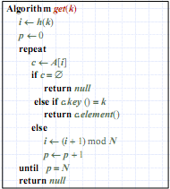
Search an item in hash tables using linear Probing
17
Consider a hash table A that uses linear probing
get(k)
  We start at cell h(k)
  We probe consecutive locations until one of the following occurs
  An item with key k is found, or
  An empty cell is found, or
  N cells have been unsuccessfully probed
Notes:
Reference: Goodrich’s
consecutive = seqential
17

Slide 18
Factors affecting Search perfomance
18
Quality of hash function
  how uniform?
  depends on actual data
Collision resolution strategy used
Load factor of the HashTable
  N/Tsize
  The lower the load factor the better the search performance
Notes:
Reference: Goodrich’s
consecutive = seqential
18

Slide 19
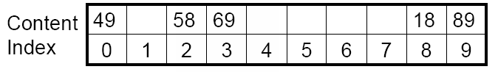
Quadratic Probing example
19
if the position k = h(x) is used, then the following positions are tried:
k = h_{i}(x) = h(x)+ i² mod M, i = 1, 2, ... (M = Tsize)
h(x) = x mod 10
Insert keys 89, 18, 49, 58, 69 in this order
Notes:
Linear probing handles collisions by placing the colliding item in the next (circularly) available table cell
19

Slide 20
Advantages and disadvantages of quadratic probing
20
One problem with quadratic probing is that probe sequences do not probe all locations in the table.
For example, if M=11, k = h(x) = x%11.
Then for those key x-s, where h(x) = 3 and collision occurs, only positions 3, 4, 7, 1, 8, 6 are probed.
When M is prime, we can make the following guarantee.
Theorem. If M is prime and the table is at least half empty, then quadratic probing will always find an empty location. Furthermore, no locations are checked twice.
Notes:
Linear probing handles collisions by placing the colliding item in the next (circularly) available table cell
20

Slide 21
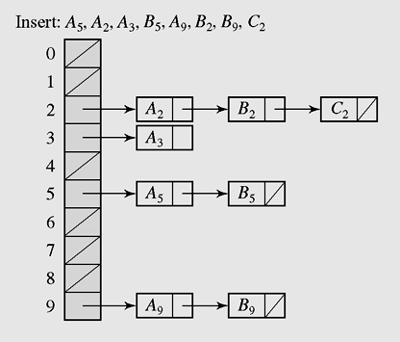
Collision Resolution
Chaining method
Keys do not have to be stored in the table itself. In chaining, each position of the table is associated with a linked list or chain of structures whose info fields store keys or references to keys.
This method is called separate chaining, and a table of references (pointers) is called a scatter table. In this method, the table can never overflow, because the linked list is extendible.
In chaining, colliding keys are put on the same linked list
Notes:
Scatter : to cause to separate widely
21

Slide 22
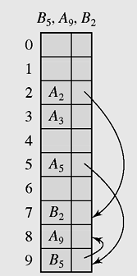
Collision Resolution
Coalesced hashing or coalesced chaining method
22
A version of chaining called coalesced hashing (or coalesced chaining) combines linear probing with chaining. Each position pos in the table contains 2 fields: info and next. The next field contains the index of the next key that is hashed to pos. By this way, a sequential search down the table can be avoided by directly accessing the next element on the linked list.
An overflow area known as a cellar can be allocated to store keys for which there is no room in the table
Coalesced hashing puts a colliding key in the last available position of the table
Notes:
Coalesce = to grow\mix together
22

Slide 23
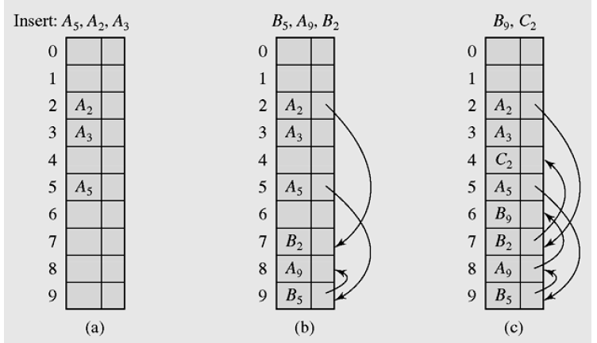
Coalesced hashing example
Coalesced hashing puts a colliding key in the last available position of the table
Notes:
Coalesce = to grow\mix together
23

Slide 24
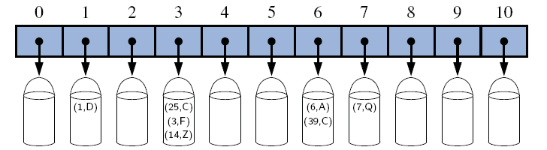
Bucket Addressing
To store colliding elements in the same position in the table can be achieved by associating a bucket with each address.
A bucket is a block of space large enough to store multiple items (a block consists of slots, each slot contains one item).
By using buckets, the problem of collisons is not totally avoided. By incorporating the open addressing approach, the colliding item can be stored in the next bucket is it has an available slot when using linear probing, or it can be stored in some other bucket when, say, quadratic probing is used. The colliding items can also be stored in an overflow area. In this case, each bucket includes a field that indicates whether the search should be continued in this area or not.
Buckets of a hash table with size 11 with entries (1,D), (25,C), (3,F), (14,Z), (6,A), (39,C), and (7,Q), using a modulo-division hash function.

Slide 25
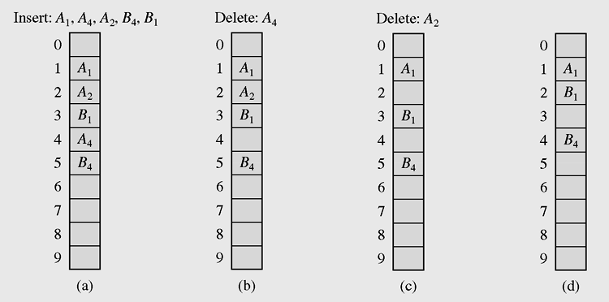
Deletion
Consider the table in which the keys are stored using linear probing. Suppose we delete A₄ and then then try to find B₄. Because when searching B we hash it to position 4 and see that this position is empty and conclude that B4 is not found (which is not true).
25
Linear search in the situation where both insertion
and deletion of keys are permitted
To avoid this situation, we mark the deleted positions only. When inserting new element to this position, we update information for new element. When there too many marked deleted elements in the table, the table is refresh (d).

Slide 26
Perfect Hash Functions
26
If hash function h transforms different keys into different numbers, it is called a perfect hash function.
If a function requires only as many cells in the table as the number of data so that no empty cell remains after hashing is completed, it is called a minimal perfect hash function
Cichelli’s method is an algorithm to construct a minimal perfect hash function

Slide 27
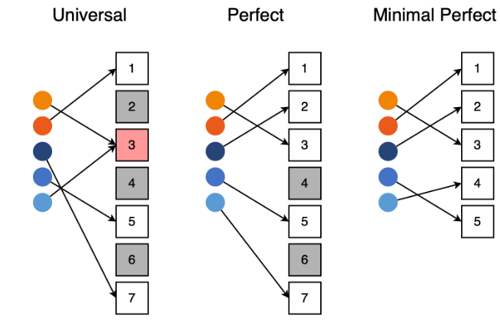
Perfect Hash Functions

Slide 28
Hash Functions for Extendible Files
There are two categories of hashing: Static hashing (the hash table is fixed-sized), and Dynamic/Extendible hashing.
Dynamic/Extendible hashing: splits and coalesces buckets appropriately with the database size.
  i.e. buckets are added and deleted on demand.
  The hash function typically produces a large number of hash values, uniformly and randomly.
  Only part of the value k = h(x) is used depending on the size of the database.
  Hash indices are typically a prefix of the entire hash value.
  More than one consecutive index can point to the same bucket.
28

Slide 29
Cryptographic Hash Functions
A cryptographic hash function is a hash function which takes an input (or message) and returns a fixed-size alphanumeric string, which is called the hash value (sometimes called a message digest, a digital fingerprint, a digest or a checksum).
The ideal hash function has three main properties:
It is extremely easy to calculate a hash for any given data.
It is extremely computationally difficult to calculate an alphanumeric text that has a given hash.
It is extremely unlikely that two slightly different messages will have the same hash.
Functions with these properties are used as hash functions for a variety of purposes, not only in cryptography. Practical applications include message integrity checks, digital signatures, authentication, and various information security applications.
Common hash functions: MD5, SHA-1, SHA-2 , SHA-3
29
Notes:
generator to create an MD5 hash of a string: https://www.md5hashgenerator.com/
MD5 conversion and reverse lookup: https://md5.gromweb.com/

Slide 30
Hash Code
If the input keys are integers then simply Key mod TableSize is a general strategy.
  Unless key happens to have some undesirable properties. (e.g. all keys end in 0 and we use mod 10)
If the keys are not integers, hash function needs more care.
  The first action that a hash function performs is to convert an arbitrary key k to an integer that is called the hash code for k; this integer need not be in the range [0,M −1], and may even be negative. For example, If the keys are real numbers between 0 and 1, we might just multiply by M and round off to the nearest integer to get an index between 0 and M-1
30
Data Structures and Algorithms in Java
Notes:
30

Slide 31
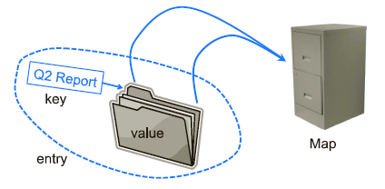
Maps - 1
A map is an abstract data type designed to efficiently store and retrieve values based upon a uniquely identifying search key for each. Specifically, a map stores keyvalue pairs (k,v), which we call entries, where k is the key and v is its corresponding value. Keys are required to be unique, so that the association of keys to values defines a mapping.
31
The figure below provides a conceptual illustration of a map using the file-cabinet metaphor. For a more modern metaphor, think about the web as being a map whose entries are the web pages. The key of a page is its URL (e.g., http://datastructures.net/) and its value is the page content.
Notes:
31

Slide 32
Maps - 2
A map models a searchable collection of key-value entries
The main operations of a map are for searching, inserting, and deleting items
Multiple entries with the same key are not allowed
Applications:
  address book
  student-record database

Slide 33
The methods of Map ADT
Map ADT methods:
  get(k): if the map M has an entry with key k, return its assoiciated value; else, return null
  put(k, v): insert entry (k, v) into the map M; if key k is not already in M, then return null; else, return old value associated with k
  remove(k): if the map M has an entry with key k, remove it from M and return its associated value; else, return null
  size(), isEmpty()
  keys(): return an iterator of the keys in M
  values(): return an iterator of the values in M

Slide 34
Map application example
Counting Word Frequencies
As a case study for using a map, consider the problem of counting the number of occurrences of words in a document. This is a standard task when performing a statistical analysis of a document, for example, when categorizing an email or news article. A map is an ideal data structure to use here, for we can use words as keys and word counts as values.

Slide 35
Hashing in java.util - HashSet and HashMap classes
HashSets store objects
  supports adding and removing in constant time
HashMaps store a pair (key,object)
  this is an implementation of a Map
  HashMap is more useful and standard
  HashMap’s main methods are:
    put(Object key, Object value)
    get(Object key)
    remove(Object key)
  All done in expected O(1) time.
  The HashMap class is roughly equivalent to Hashtable, except that it is unsynchronized and permits nulls.
  An instance of HashMap has two parameters that affect its performance: initial capacity and load factor. The capacity is the number of buckets in the hash table. The load factor is a measure of how full the hash table is allowed to get before its capacity is automatically increased.
A hash map is a collection of singly linked lists (buckets); that is, chaining is used as a collision resolution technique
Data Structures and Algorithms in Java

Slide 36
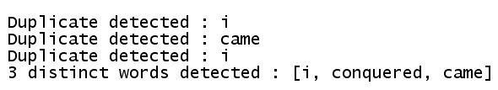
HashSet example
import java.util.*;
public class Main
{ public static void main(String args[])
{ Set s = new HashSet();
String [] a = {"i", "came", "i", "came", "i", "conquered"};
for(int i=0; i<a.length;i++)
{ if(!s.add(a[i]))
System.out.println("Duplicate detected : " + a[i]);
}
System.out.println(s.size() + " distinct words detected : " + s );
}
}
Data Structures and Algorithms in Java

Slide 37
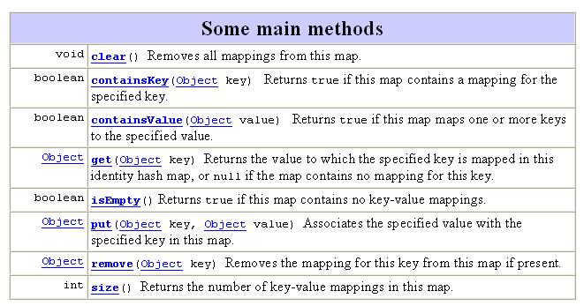
HashMap class
Hash table based implementation of the Map interface. This implementation provides all of the optional map operations, and permits null values and the null key. (The HashMap class is roughly equivalent to HashTable, except that it is unsynchronized and permits nulls.)
37
Data Structures and Algorithms in Java

Slide 38
HashMap class example
38
import java.util.*;
public class Main
{ public static void main(String args[])
{ HashMap hMap = new HashMap();
hMap.put("One", new Integer(1));
hMap.put("Two", new Integer(2));
Object obj = hMap.get("One");
System.out.println(obj);
}
}
Output is: 1
Data Structures and Algorithms in Java

Slide 39
Applications of Hashing
There are many areas where hashing is applicable.Here are common ones:
Databases: Efficient retrieval of records.
Compilers: Symbol tables.
Games: Lookup board configuration to find the move that goes with it.
UNIX shell: Quick command lookup.
IP Routing: Fast IP address lookup.
Data Structures and Algorithms in Java

Slide 40
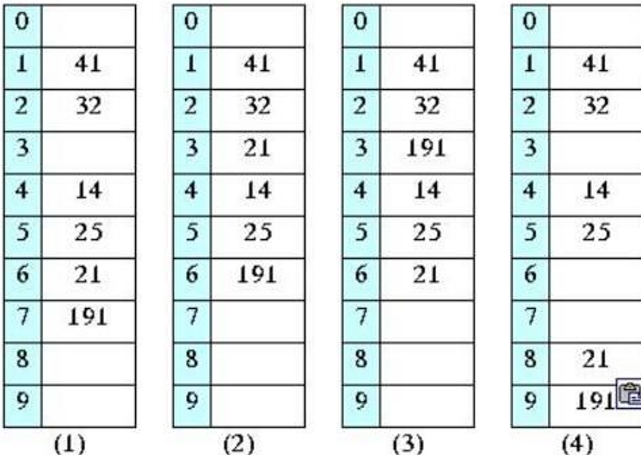
Exercise
1. What is the value of the Boundary Folding Hash Function if
K = 45-65-79-8 and TSize = 100?
2.Given the division hash function h(x) = x%M. where M = 10 and Collision Resolution is linear probing. How the hash table looks like after inserting the following keys sequentially?
25, 41, 14, 32, 191, 21

Slide 41
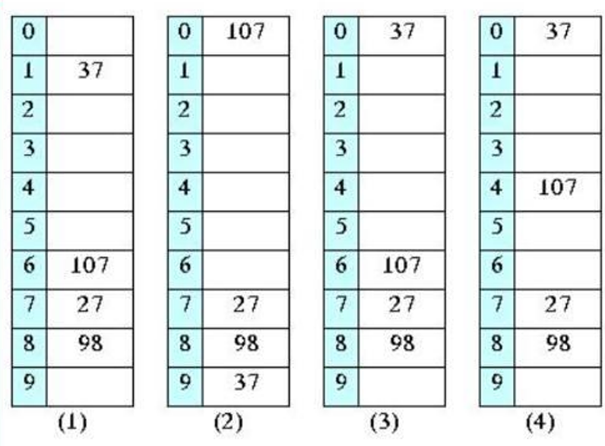


Exercise
Given the division hash function h(x) = x%M. where M = 10 and Collision Resolution is quadratic probing, i.e. when inserting a key x, the collision is resolved by finding an available position at (h(x) + i^2)%M). i=1. 2.
How the hash table looks like after inserting the following keys
sequentially? 27, 98, 37, 107

Slide 42
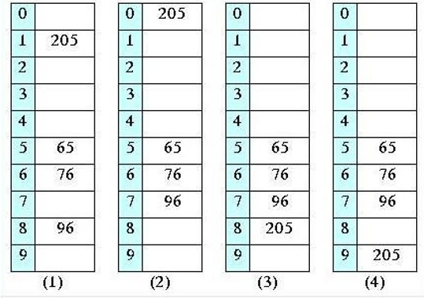

Exercise
Given the division hash function h(x) = x%M. where M = 10 and Collision Resolution is quadratic probing. i.e. when inserting a key x. the collision is resolved by finding an available position at (h(x) + i^2)%M), i=1, 2,... How the hash table looks like after inserting the following keys sequentially? 65, 76, 96, 205

Slide 43
Exercise
Specify the correct statement about bucket addressing method for handling collision (select the best answer).
A. Bucket is a linked list which holds items in the hash table.
B. A bucket is a block of space which is large enough to store all colliding items.
C. Colliding elements in the same position in the hash table are placed on a bucket associated with that
position.
D. All of the statements are incorrect.

Slide 44
Summary
Hash functions include the division, folding,
mid-square, extraction and radix
transformation methods
Collision resolution includes the open addressing, chaining, and bucket addressing methods
A HashMap is a is an implementation of a Map ADT using hashing technique.
HashSet is another implementation of a set
(an object that stores unique elements)
A HashTable is roughly equivalent to a HashMap except that it is synchronized and does not permit null values with methods to operate on hash tables
Data Structures and Algorithms in Java

Slide 45
Reading at home
Text book: Data Structures and Algorithms in Java
10 Maps, Hash Tables, and Skip Lists - 401
10.2 Hash Tables - 410
10.2.1 Hash Functions - 411
10.2.2 Collision-Handling Schemes - 417
10.2.3 Load Factors, Rehashing, and Efficiency - 420
10.2.4 Java Hash Table Implementation - 422
Data Structures and Algorithms in Java

